Slide 1
Cache Memory
Cache Memory is a special very high-speed memory. It is used to speed up and synchronize with high-speed CPU.
It holds frequently requested data and instructions so that they are immediately available to the CPU when needed.
Cache memory is used to reduce the average time to access data from the Main memory.

Slide 2
Use of a Cache Memory

Slide 3
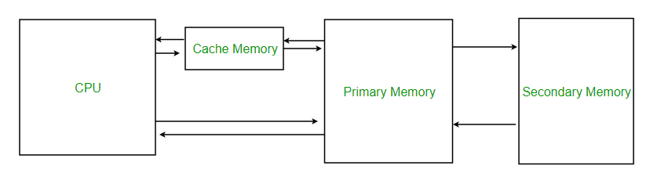

Slide 4
The effectiveness of the cache mechanism is based on a property of computer programs called locality of reference.
Locality of Reference :Many instructions in localized areas of the program are executed repeatedly during some time period and remainder of the program is accessed relatively infrequently.
2 ways of locality of reference.
They are :
Temporal(Based on time): The recently executed instruction are likely to be executed again very soon.
Examples: Loops, repeatedly called subroutines, setting a variable and then reusing it many times
Spatial(Based on space): The instructions in close proximity to recently executed instruction are likely to be executed soon.
Examples: Arrays and program code

Slide 5
Cache Memory in Computer Organization
If the active segment of the program is placed in cache memory, then the total execution time can be reduced significantly.
The temporal aspects of the locality of reference suggest that whenever an instruction item(instruction or data) is first needed, this item should be brought into the cache where it will hopefully remain until it is needed again.
The spatial aspects suggests that instead of fetching just one item from the main memory to the cache, it is useful to fetch several items that reside at adjacent addresses as well.
The term block is used to refer to a set of contiguous address locations of same size.
Another term that is used to refer to a cache block is cache line.

Slide 6
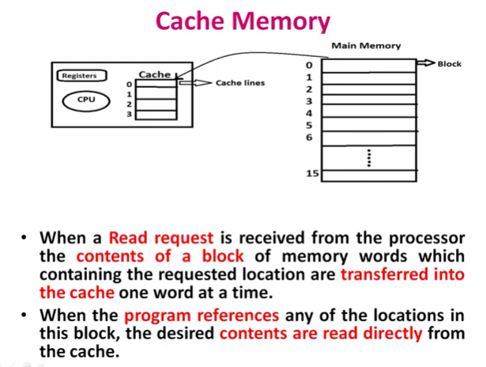

Slide 7
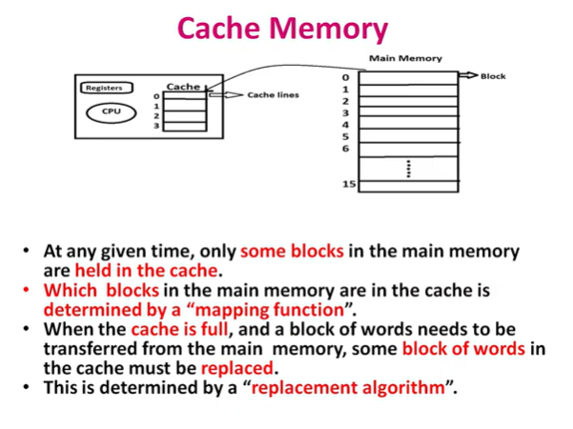

Slide 8
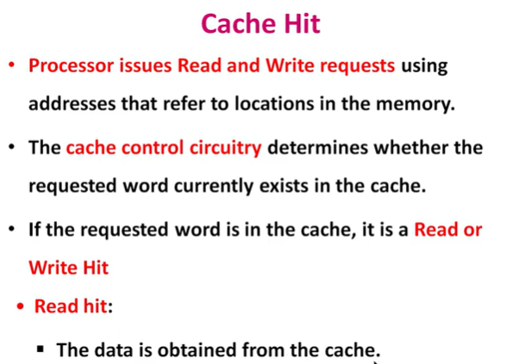

Slide 9
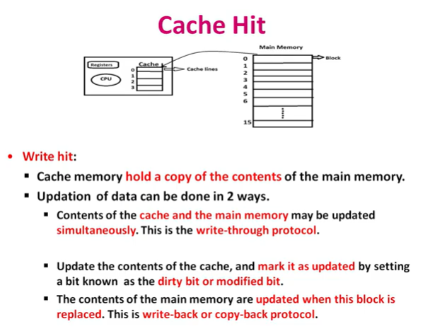

Slide 10
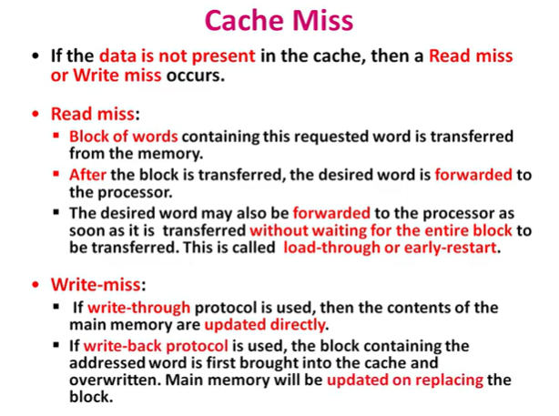

Slide 11
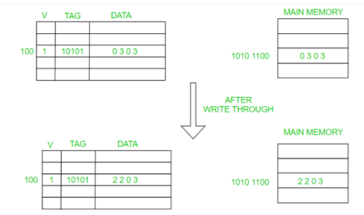
The write operation proceeds in 2 ways. They are:
Write-through protocol
Write-back protocol
Write-through protocol:
Here the cache location and the main memory locations are updated simultaneously.
The write- through protocol is simpler, but it results in unnecessary write operations in the main memory when a given cache word is updated several times during its cache residency.

Slide 12
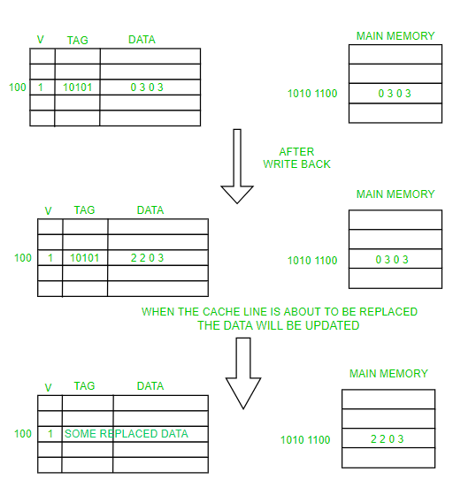
Write-back protocol:
This technique is to update only the cache location and to mark it as with associated flag bit called dirty/modified bit.
The word in the main memory will be updated later, when the block containing this marked word is to be removed from the cache to make room for a new block.
If the requested word currently does not exist in the cache during read operation, then read miss will occur.
To overcome the read miss Load through / early restart protocol is used.

Slide 13
When the cache is full and a memory word (instruction or data) that is not in the cache is referenced, the cache control hardware must decide which block should be removed to create space for the new block that contains the referenced word.
The collection of rules for making this decision constitutes the replacement algorithm.
The cache control circuit determines whether the requested word currently exists in the cache.
If it exists, then Read/Write operation will take place on appropriate cache location.
In this case Read/Write hit will occur.
In a Read operation, the memory will not be involved.

Slide 14
When a Read request is received from the processor ,the contents of a block of memory words containing the location specified are transferred into the cache one word at a time.
When the program references any of the locations in this block, the desired contents are read directly from the cache.
The Cache memory stores a reasonable number of blocks at a given time but this number is small compared to the total number of blocks available in Main Memory.
The correspondence between main memory block and the block in cache memory is specified by a mapping function

Slide 15
MAPPING FUNCTIONS
To specify where memory blocks are placed in the cache
Three types of mapping functions
Direct mapping
Associative mapping
Set associative mapping

Slide 16
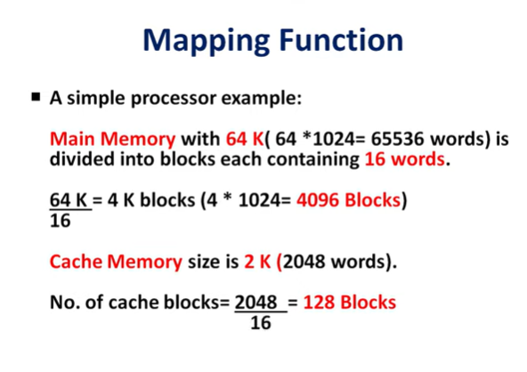

Slide 17
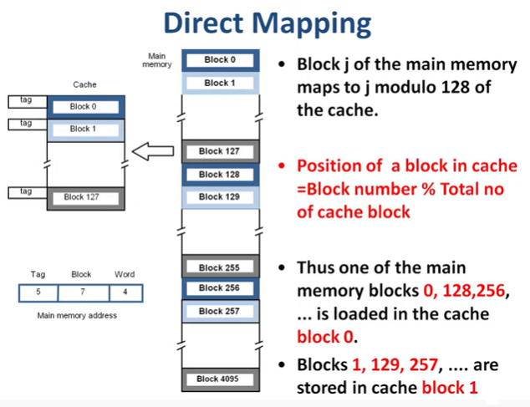

Slide 18
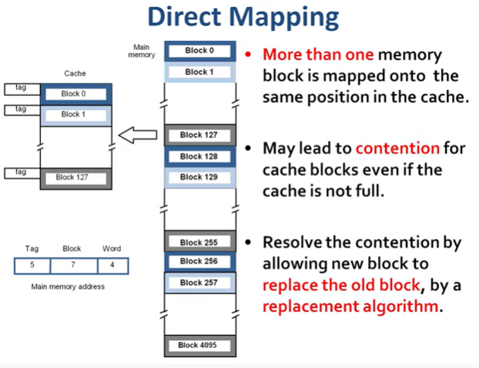

Slide 19
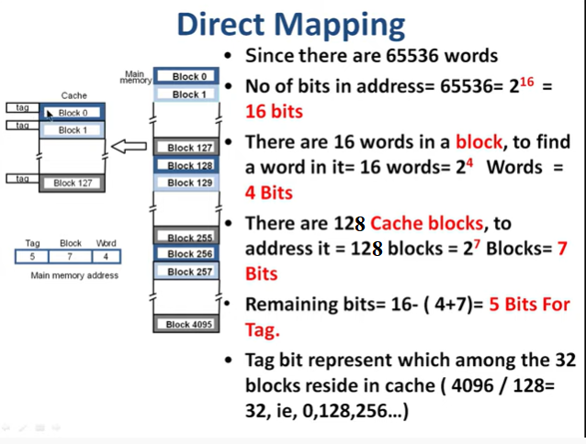

Slide 20
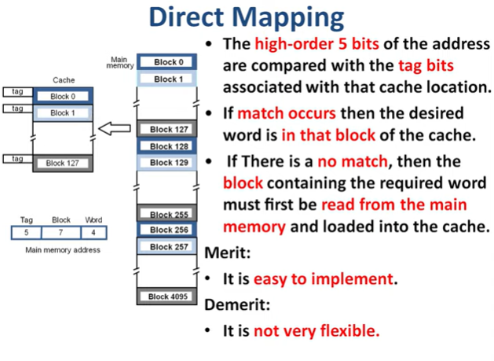

Slide 21
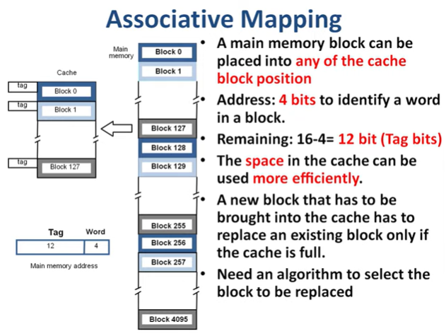

Slide 22
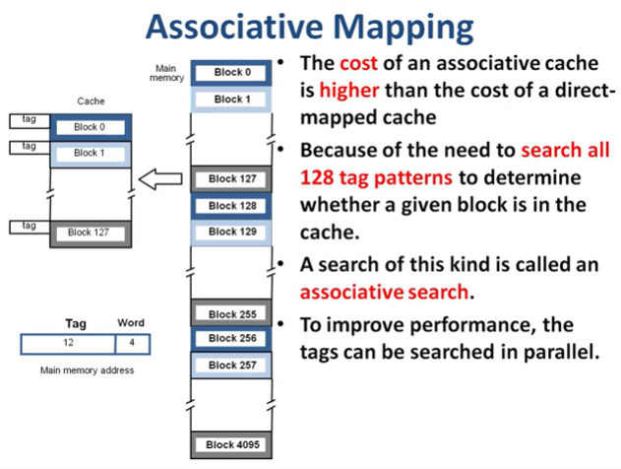

Slide 23
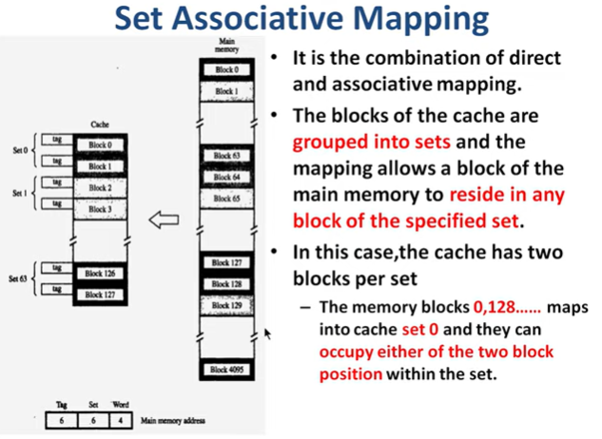

Slide 24
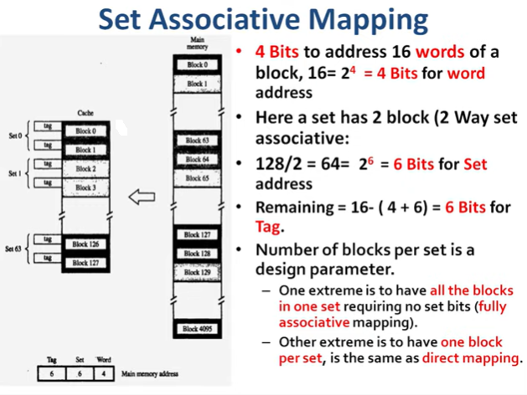

Slide 25
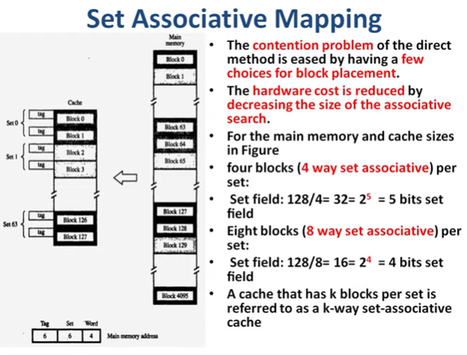

Slide 26
Problem:
A computer system uses 16-bit memory addresses. It has a 2K-byte cache organized in a direct mapped manner with 64 bytes per cache block. Assume that the size of each memory word is 1 byte. Calculate the number of bits in each of the Tag, Block, and Word fields of the memory address.

Slide 27
Problem:
Block size = 64 bytes = 2⁶bytes = 2⁶ words (since 1 word = 1 byte)
Therefore, Number of bits in the Wordfield = 6
Cache size = 2K-byte = 2*1024=2048 bytes
Number of cache blocks = Cache size / Block size = 2048/64= 32
Therefore, Number of bits in the Blockfield = 5
Total number of address bits = 16
Therefore, Number of bits in theTagfield = 16 - 5 - 6 = 5
For a given 16-bit address, the 5 most significant bits, represent theTag, the next 5 bits represent theBlock, and the 6 least significant bits represent theWord(b).

Slide 28
REPLACEMENT ALGORITHMS
In a direct-mapped cache ,the position of each block is predetermined; hence, no replacement strategy exists.
In associative and set associative caches there exists some flexibility.
When a new block is to be brought into the cache and all the positions that it may occupy are full, the cache controller must decide which of the old blocks to overwrite.
The property of locality of reference in programs gives a clue to a reasonable strategy.

Slide 29
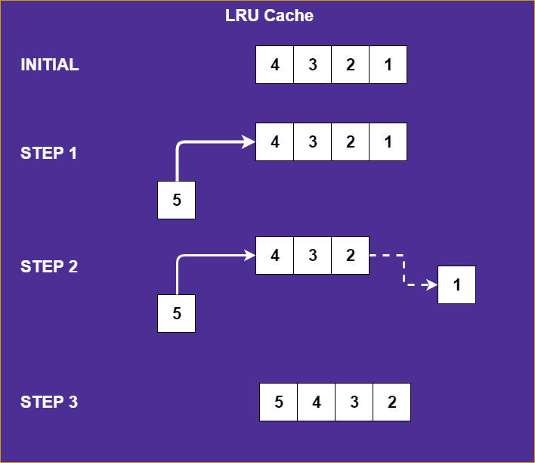
LRU
The least recently used (LRU) algorithm is one of the most famous cache replacement algorithms.
As the name suggests, LRU keeps the least recently used objects at the top and evicts objects that haven't been used in a while if the list reaches the maximum capacity.
So it's simply an ordered list where objects are moved to the top every time they're accessed; pushing other objects down.

Slide 30
Because programs usually stay in localized areas for reasonable periods of time ,there is high probability that the blocks that have been referenced recently will be referenced again soon.
Therefore, when a block is to be overwritten, it is sensible to overwrite the one that has gone the longest time without being referenced.
This block is called least recently used(LRU) block, and the technique is called the LRU replacement algorithm.

Slide 31
To use the LRU algorithm, the cache controller must track references to all blocks as computation proceeds.
Suppose it is required to track the LRU block of a four-block set in a set-associative cache.
A 2bit counter can be used for each block. When a hit occurs, the counter of the block that is referenced is set to 0.
When a miss occurs and the set is not full, the counter associated with the new block loaded from the main memory is set to 0,and the values of all other counters are increased by one.
When a miss occurs and the set is full, the block with the counter value 3 is removed, the new block is put in its place, and its counter is set to 0.
The other 3 blocks counters are incremented by one.

Slide 32
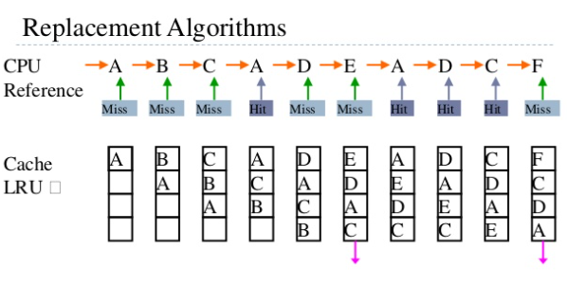

Slide 33
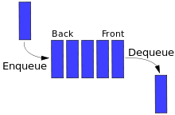
LFU
The least frequently used (LFU) algorithm works similarly to LRU except it keeps track of how many times an object was accessed instead of how recently it was accessed.
Each object has a counter that counts how many times it was accessed. When the list reaches the maximum capacity, objects with the lowest counters are evicted.
FIFO
FIFO (first-in-first-out) is also used as a cache replacement algorithm . Objects are added to the queue and are evicted with the same order.

Slide 34
Random Replacement (RR)
This algorithm randomly selects an object when it reaches maximum capacity. It has the benefit of not keeping any reference or history of objects and being very simple to implement at the same time.

